Slide 1

UNIVERSITY INSTITUTE OF SCIENCES
Academic Unit V
Bachelor of Engineering
(Computer Science & Engineering)
Biology For Engineers
23SZT148
Patient isolation, and accident prevention
DISCOVER . LEARN . EMPOWER

Slide 2
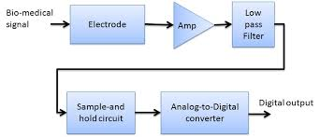

Course Outcome
CO Number | Title | Level
CO1 | Identify the biological concepts from an engineering perspective. | Remember
CO2 | Development of artificial systems mimicking human action. | Understand
CO3 | Explain the basic of genetics that helps to identify and formulate problems | Understand
CO4 | Apply knowledge of measurement system, biomedical recording system and biosensors to excel in areas such as entrepreneurship, medicine, government, and education. | Understand
CO5 | Integrate biological principles for developing next generation technologies
Will be covered in this lecture
https://images.app.goo.gl/5obqqxo93P2UBmdU6

Slide 3
SYLLABUS
Unit-3 | Bio Medical Instrumentation | Contact Hours: 15
Chapter 1 Electrical stimulus and biophysical activity Chapter 2 Biomedical recording system Chapter 3 Tissue Engineering | Electrical stimulus and biophysical activity: Patient, electrical shock and hazards, leakage current, Electrical activity of heart (ECG), Electrical activity of brain (EEG), Electrorentinogram (ERG), Electro-occologram (EOG), Electromyogram (EMG). Biomedical recording systems: Basic Recording system, General consideration for signal conditioners Preamplifiers, Differential Amplifier, Isolation Amplifier, Vectorcardiograph, Phonocardiograph, Other biomedical records, Patient isolation, and accident prevention. Tissue Engineering: Recombinant DNA technology, Stem cell biology & Tissue Engineering.

Slide 4
Patient Safety

Slide 5
Danger to Patients
In a clinical environment patient is exposed to various risks, more than a typical workplace or at home
Frequent invasive (blood) operations
Penetration through skin or mucous membranes
Presence of potentially hazardous chemicals and substances - anesthetics, medicines, medical gases
Sources of infection - particularly "hospital infection"
Various sources of energy that penetrate into or through the patient: current, voltage, ionizing and non-ionizing radiation, sound and ultrasound, electric and magnetic field, UV radiation, lasers, microwave radiation, mechanical stress, etc.

Slide 6

WHAT IS SAFETY
S – Sense the error
A – Act to prevent it
F – Follow Safety Guidelines
E – Enquire into accidents/Deaths
T – Take appropriate remedial measure
Y – Your responsibility

Slide 7
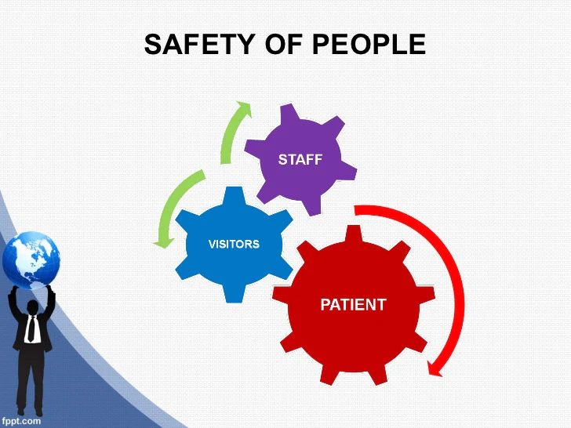
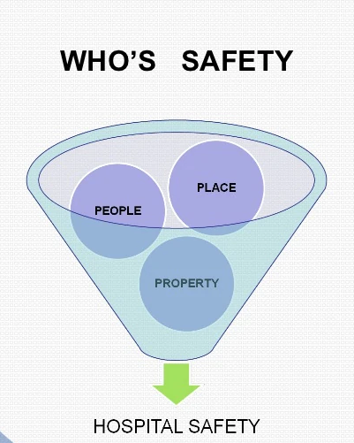
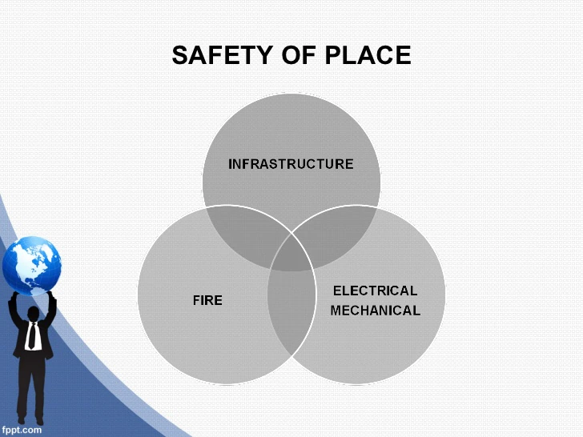
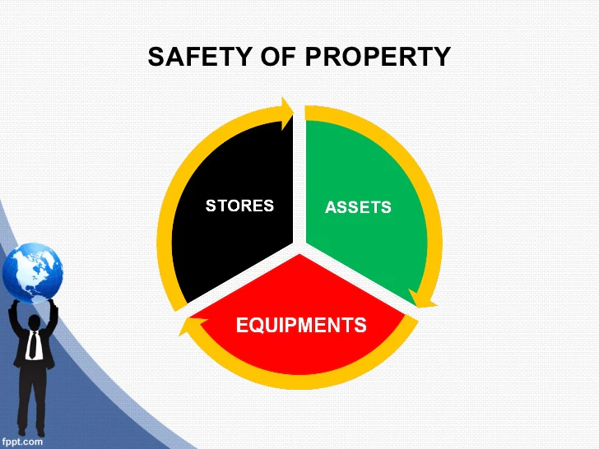

Slide 8
PATIENT SAFETY
Patient safety is the absence of preventable harm to a patient during the process of health care.
The discipline of patient safety is the coordinated efforts to prevent harm to patients, caused by the process of health care itself.
It is generally agreed upon that the meaning of patient safety is…“Please do no harm”.
The concept of patient safety comes from the HIPPOCRATIC OATH “I will prescribe regimens for the good of my patients according to my ability and my judgment and ”never do harm” to anyone.”
Improving Patient Safety means reducing patient harm.
Hospitals were founded to give care to those who need it and to keep patients safe is their moral duty

Slide 9
Principle of Patient Safety
Proper identification of patient and matching to their care elements
Prevention of patient hand over error and safety during transition
Assessing medical accuracy while giving care to a patient
Performance of correct procedure at correct body site
Take appropriate precautionary measures to avoid infection

Slide 10
Patient Safety
Medical Safety
Surgical Safety
Electrical Safety
Laboratory Safety
Sanitation Infection Control
Blood Safety
Equipment Installation Safety
Environmental Safety

Slide 11
Safe Medical Technology Development
Electrical MT security is considered:
Physiological effects of electricity
Possibility (risk) of failures and their consequences
Methods of patients and staff protection
Standards describing electrical safety
Electrical safety testing modes
Understanding the possible dangers and risks
Implementation in achieving security

Slide 12
Electrical Current:
Electrical Current
Requires a closed circuit
Follows the path of least resistance (much like water)
Electrical (functional) currents form an integral part during monitoring, treatment and diagnosis of patients
But can cause injury or even result in death as a result of muscle stimulation, tissue burns or trigger other events (e.g., ignition of pure oxygen)
Risk of (non-functional) electrical leakage is relatively small but always present.
Life saver in defibrillators (functional current)
Preventative Maintenance
Objective is to prevent or find potential faults
Visual Inspection
Testing means of protection
Line cord
Ground continuity
Insulation
Leakage currents
Performance testing
Data capture and management

Slide 13
Leakage Current
The leakage consists of any current, including capacitively coupled current, not intended to be applied to a patient, but which may pass from exposed metal parts of an appliance to the ground or to other accessible parts of an appliance.
Normally, this current is shunted around the patient via the ground conductor in the power cord. However, as this current increases, it can become a hazard to the patient.
Without proper use of grounding, leakage currents could reach values of 1,000 μA before the problem is perceived.
Leakage currents are involuntary currents that flow when a resource or electrical medical device is operating in a normal, faultless state.
Therefore, leakage currents are not fault currents. Fault currents only occur in the event of a fault (e.g., defective insulation).
Medical electrical equipment, even though operating perfectly, may still be hazardous to the patient.
This is because every piece of electrical equipment produces a leakage current.
A patient can be injured by a leakage current of as little as 10 to 180 μA. Ventricular fibrillation can also occur from exposure to this leakage current.

Slide 14
Electrical Shock Hazards
The severity and effects of an electrical shock depend on a number of factors, such as the pathway through the body, the amount of current, the length of time of the exposure, and whether the skin is wet or dry. Water is a great conductor of electricity, allowing current to flow more easily in wet conditions and through wet skin.
The effect of the shock may range from a slight tingle to severe burns to cardiac arrest.
Electrical shock occurs when the body becomes part of the electric circuit, either when an individual comes in contact with both wires of an electrical circuit, one wire of an energized circuit and the ground, or a metallic part that has become energized by contact with an electrical conductor.
Potential places where this can happen include:
Panel boards and switchboards
Motor control centers
Metal-clad switchgear
Transformers
Motor starters and drive cabinets
Fused disconnects
Any place that can have equipment failure

Slide 15
Electrical Shock Hazards
Body (tissue) becoming a part of an electrical circuit
The amount (amplitude) of electricity often depends on the ratio of voltage present and the sum of all (serially connected) impedance
Usually, the highest impedance is the impedance of the skin
The consequence of current flow:
Electric stimulation of excitable tissue (nerve and muscle)
Heating of tissues (a result of tissue resistance)
Electrochemical burns and tissue damage for DC current and very high voltage
Before placing the electrodes the skin should be dry.
Buffer amplifier converts low impedance signals to high impedance signals.

Slide 16
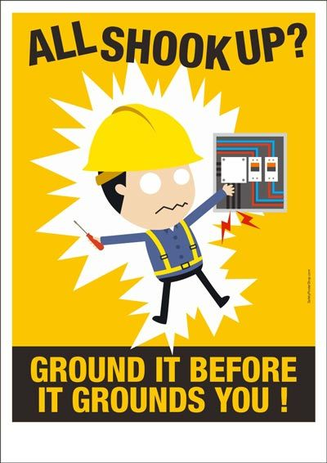
Protective Grounding
Generally, patients are only occasionally and accidentally exposed to risk of getting in touching with devices whose conductive parts may be energized
In hospitals, especially in intensive care units, patients are deliberately connected to the diagnostic and/or therapeutic electrical devices/equipment
Particularly careful with the isolation of any conductive parts connected to the heart or its vicinity from all other conductive parts
All conductive parts in the vicinity of the patient must be connected to a single point grounding (eg, metal bed, cupboard, etc.)
Periodic testing of the grounding impedance must be provided
Tolerable difference in potential between the grounded conductive parts in clinical areas:
In the general - of 500 mV – intensive care and other critical cases- of 40 mV

Slide 17
Patient isolation
Following instructions should be followed if person comes in contact with electric shock;
To turn off power.
Unplug an appliance if plug is undamaged or shut off power via circuit breaker, fuse box, or outside switch.
If you can't turn off power:
Stand on something dry and non-conductive, such as dry newspapers, telephone book, or wooden board.
Try to separate the person from current using non-conductive object such as wooden or plastic broom handle, chair, or rubber doormat.
If high voltage lines are involved:
The local power company must shut them off.
Do not try to separate the person from current if you feel a tingling sensation in your legs and lower body. Hop on one foot to a safe place where you can wait for lines to be disconnected.

Slide 18
THANK YOU

